Slide 1
Amazon Quick
GTech

Slide 2
Content
Introduction to Amazon Quick
Key Features of Amazon Quick
How amazon Quick Works
Connecting Business Data and Applications
AI Agents and Taking Action
Quick Research and Knowledge Discovery
Quick Sight and Business Intelligence
Quick Flows, Quick Automate, and Apps
Real-World Example
Security, Limitation and Best Practices
Conclusion

Slide 3
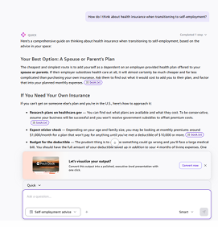
Introduction to Amazon Quick
AI-powered workspace for business productivity.
Uses natural-language chat to understand user requests.
Connects AI agents with business data and applications.
Supports research, data analysis, and task automation.
Includes dashboards and interactive business insights.
Helps users move from finding information to taking action.

Slide 4
Key Features of Amazon Quick
AI Agents: Answer questions and help complete tasks.
Quick Research: Produces detailed research with citations.
Quick Slight: Creates dashboards and data visualizations.
Quick Flows: Supports AI-powered workflow creation.
Quick Automate: Helps automate larger business processes.
Apps in Quick: Builds interactive applications from natural-language instructions.

Slide 5
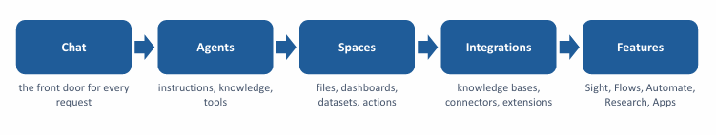
How Amazon Quick Works
Users begin by entering a question or instruction in chat.
AI agents interpret the request and determine the next steps.
Connected data sources provide relevant information.
Space organize documents, dashboards, and other resources.
Tools and integrations allow supported actions in external applications.
Results may include answers, reports, visualizations, or completed tasks.

Slide 6
Connecting Business Data and Applications
Connects supported business data sources and applications.
Uses knowledge bases and connectors to access relevant information.
Can work with documents, databases, and business application data.
Supports resources such as files, dashboards, and datasets.
Spaces organize information for teams and specific projects.
Permissions help control which resources each user can access.

Slide 7
AI Agents and Taking Action
Agents use instructions, knowledge sources, and tools.
Custom agents can support specific business roles.
Agents can retrieve information and help plan tasks.
Connected actions can interact with external applications.
Examples include creating tickets or updating supported records.
Permissions and human approval may be needed for sensitive actions.

Slide 8
Quick Research and Knowledge Discovery
Conducts detailed research across supported information sources.
Can use business data and public web information.
Organize findings into structured reports.
Provides citations to help users verify important claims.
Helps compare information and identify useful insights.
Requires review of sources and conclusions before important decisions.

Slide 9
Quick Sight and Business Intelligence
Provides business intelligence and data visualization.
Creates interactive dashboards and charts.
Helps users explore business performance.
Supports analysis of connected datasets.
Natural-language questions can help users investigate data.
Turns raw numbers into information that supports decisions.

Slide 10
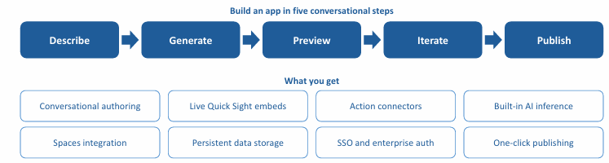
Quick Flow, Quick Automate, and Apps
Quick Flows: Connect steps to create AI-powered workflows.
Quick Automate: Supports end-to-end business process automation.
Apps in Quick: Builds interactive web applications.
Natural-language instructions can help define what to bud.
Integrations connect workflows with supported tools and data.
Testing and monitoring help ensure workflows behave as expected.

Slide 11
Real-World Example: Sales Performance Assistant
A company connects sales datasets and relevant documents.
A manager asks why monthly sales have declined.
Amazon Quick helps analyze available business information.
Quick Sight visualizations show trends and comparisons.
Quick research can help gather supporting context.
A report or flow-up workflow can be prepared for review.

Slide 12
Security, Limitations, and Best Practices
Configure identity, permissions and access to connected resources.
Use reliable and up-to-date data sources.
Review outputs before making important decisions.
Test agents, integrations, and automated workflows.
Monitor usage, performance, and subscription costs.
Keep human oversight for sensitive or high-impact actions.

Slide 13
Conclusion
Amazon Quick brings AI assistance into a business workspace.
Agents use instructions, tools and connected knowledge.
Quick Research helps investigate topics and produce cited reports.
Quick Sight supports dashboards and data analysis.
Quick flows, Quick Automate, and Apps help reduce manual work.
Reliable results require good data, security, testing and human judgment.

Slide 14


